Slide 1

uNit 2 –Operating Systems
Computing Systems

Slide 2

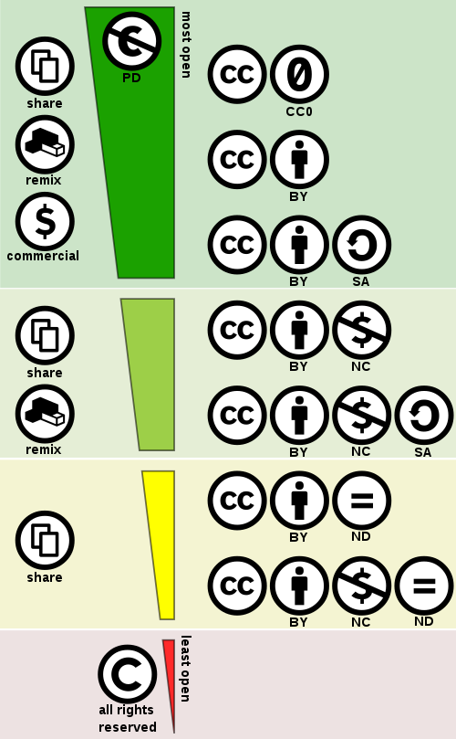
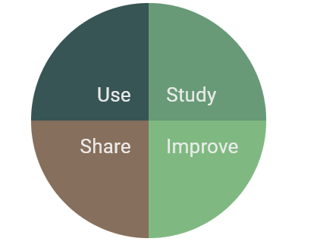
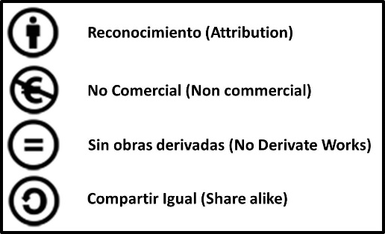
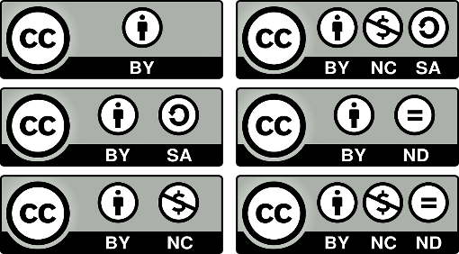

Operating System & freedoms
License it’s a contract: Developer User
Patent is a guarantee of rights to new products for a specific set period of time.
Copyright is a legal protection against piracy
GNU GPL
General Public License
EULA End user license agreement.
OEM Original equipment manufacturing.
Others such as educational, volumes or blister.
GNU’s Not Unix
In 1985 Richard Stallman founded the Free Software Foundation
Font:https://fsfe.org/
Open Source was a marketing strategy
In 1998
became a free program
Font:https://creativecommons.org/

Slide 3
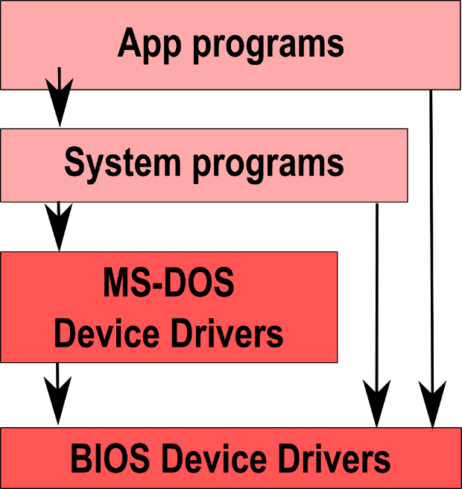
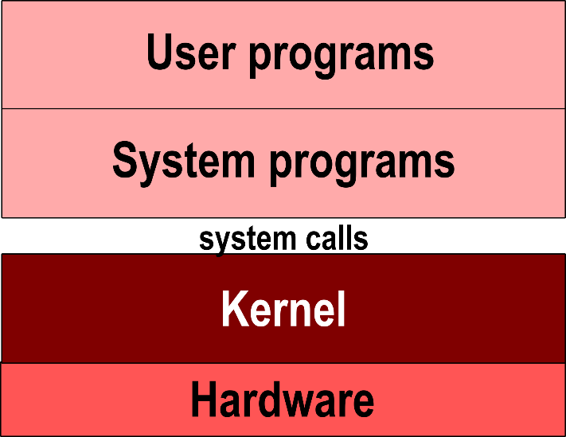
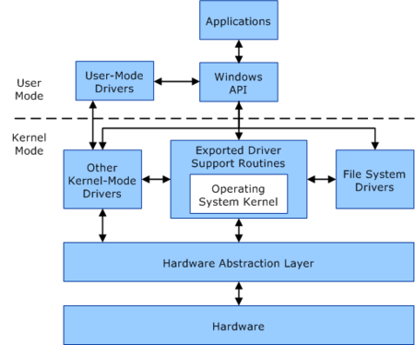
The Origin
MS-DOS
UNIX
Microsoft Disk Operating System
UNiplexed Information Computing System
Monolithic OS
Windows-NT
Standard POSIX
Portable Operating System Interface.
IEEE Institute of Electrical and Electronics Engineers.
X for UNIX contribution but Windows NT is compatible.
Font:https://www.genbeta.com/

Slide 4
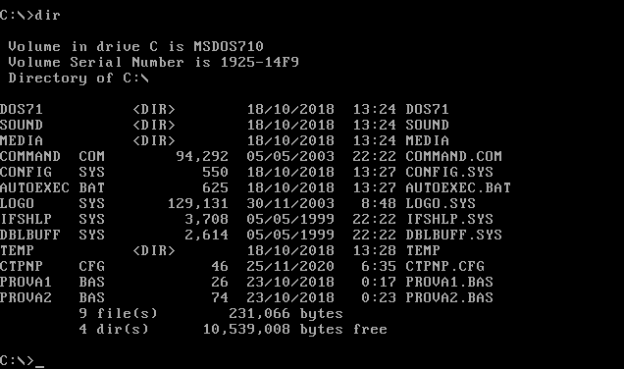
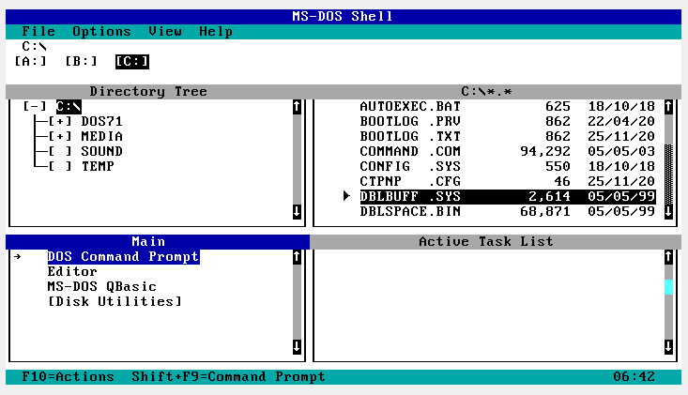
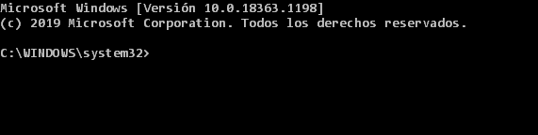
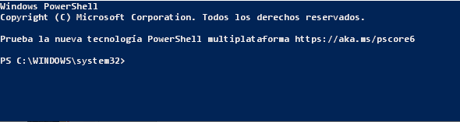
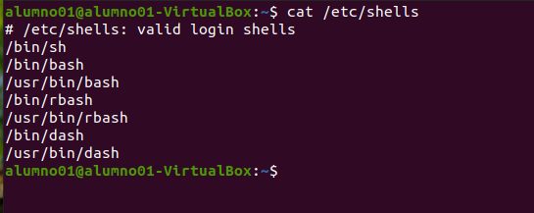
OS-Functions and components
Manager:
MS-DOS
Process and resource: Program become a process.
Memory: Allocate memory to user processes.
I/O System: Hardware abstraction.
Files: Create, delete and read.
Network: Depending on the distributed system or not.
Protection System: Memory zones and resource access.
Command interface: Choice of special software or integrated interpreter.
CMD
.net,
C++
PowerShell

Slide 5
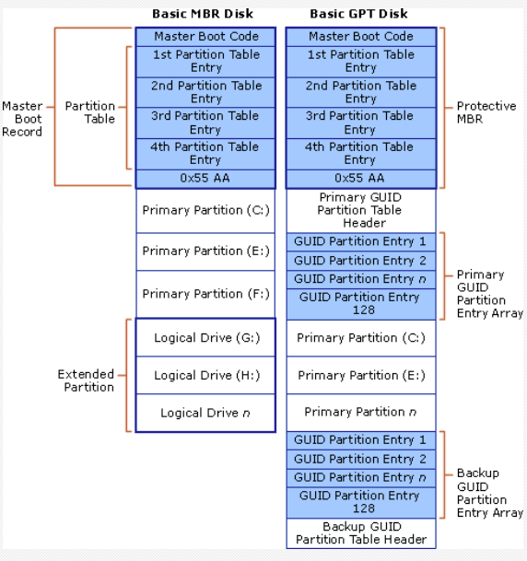
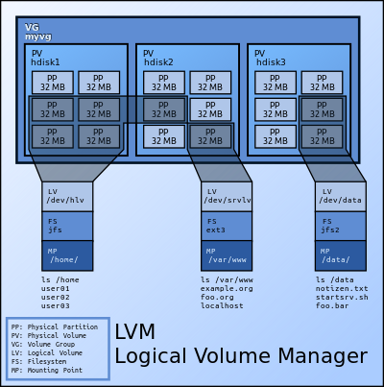
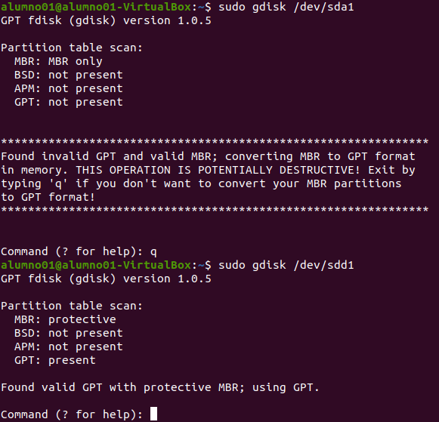
Logical partitioning
LVSM
Logical volume System Management
MBR for Legacy
Block position 32 bits
Block size 512 bytes
Max 2 TB
# fdisk /dev/sdb
GPT for UEFI
Block position 64 bits
Block size 512 bytes
Max 9 ZiB (Zebibyte)
# gdisk /dev/sdb
Font:https://en.wikipedia.org/

Slide 6

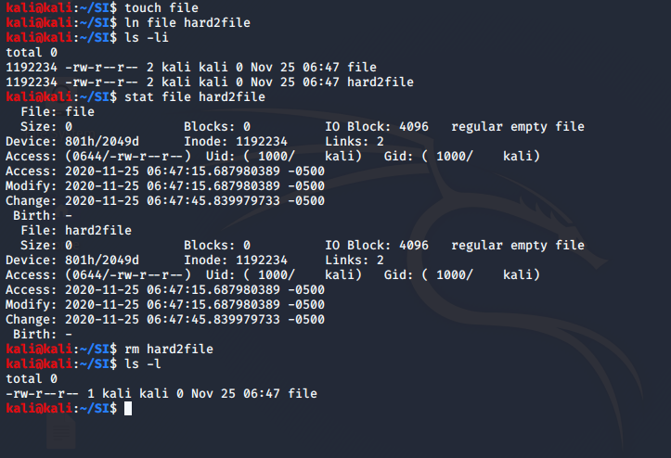
File system management
ext2
 | INODE
 | Owner and Group
 | File types
 | Permits
 | Date
 | Number Hard Links
 | Size in Bytes
 | Number used Blocks
Con t en t Tab l e | Direct 0
 | Direct 1
 | Direct 2
 | Direct 3
 | Direct 4
 | Direct 5
 | Direct 6
 | Direct 7
 | Direct 8
 | Direct 9
 | Direct 10
 | Direct 11
 | Indirect
 | Double Indirect
 | Triple Indirect
n*(12+256+256^2+256^3)
BLOCK is a basic unit .
File size is a number of whole blocks.
Inode: Data structure containing the information that describes and represents a file. # stat file.doc
Superblok: Metadata zone. At least one.
Type, size, state and position, inode table, etc.
Catalogue table: Inode and file name association. It is a Directory.
Hard Link: Adds association in a catalogue table.
512
1024
2048
4096
8GB
17GB
35GB
69GB

Slide 7
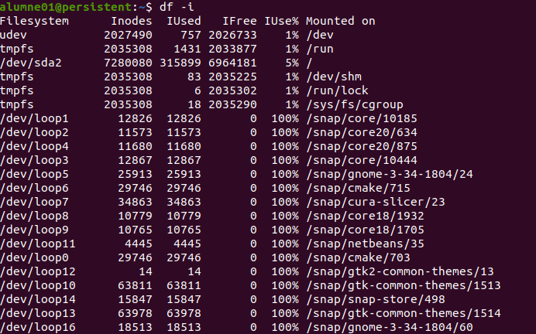
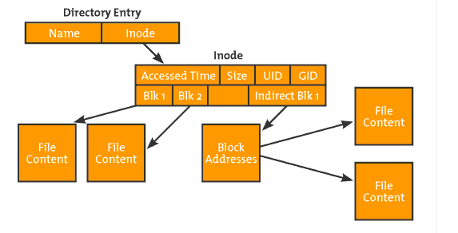
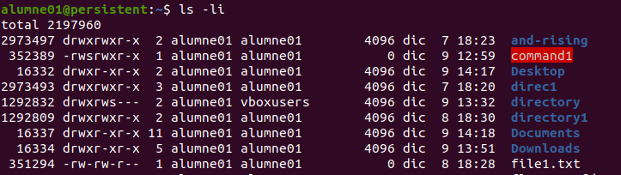
Font:https://www.sololinux.es

Slide 8
Journalig
Circular log file that records changes before they are made
ext3
ext2 support
Third extended filesystem has journaling.
File max size 2 TB
Partition max size 32 TB
ext4
ext3 support
Has extends.
File max size 16 TB
Partition max size 1 EB
BTRFS Better filesystem
Subvolumes concept.
Protection System for data and metadata with checksums.
Allows snapshots.
Add and remove volume in production.
Similar to LVM.
Extends
Pre-assign block in continue zones improve fragmentation
Subvolume
File Subsystem inside a filesystem. Useful to be mounted, allows cotes, snapshots and It is not a block Device It is like a folder.

Slide 9
MS-DOS
File Name | Extension | Attributes | Reserved | Time | Date | Firts Block Number | Size
8 bytes | 3 bytes | 1 byte | 10 bytes | 2 bytes | 2 bytes | 2 bytes | 4 bytes
32 bytes
No soft or hard links
Uses a File Allocation Table FAT
FAT-12, FAT-16, FAT-32 based on # bits in disk address
Disk block is some múltiple of 512 bytes.
Block size is called cluster size
FAT-32
File Name | Extension | Attributes | NT | Sec | Creation Data/time | Last acces | Lower 16 bits of starting block | Last Write Data/time | Lower 16 bits of starting block | Size
8 bytes | 3 bytes | 1 byte | 1 | 1 | 4 bytes | 2 | 2 | 2 bytes | 2 bytes | 4 bytes
32 bytes

Slide 10
NTFS- New Technology Filesystem
MTF | MTF ZONE TO GROW | PLACE FOR FILES | COPY MTF | PLACE FOR FILES
Partition also call a volume with max size 2⁶⁴ bytes
Sector size 512 bytes
Cluster sisè from 512 bytes to 64kB, usually 4kB used but NTF alows define it.
Addressing:uses logical clúster numbers
Files Structure: Object with certain attributes and user data in data attributes
Master File Table (MFT)
Every System component is a file and MFT is the most important
Has information of every other file on the disk
Large files or high fragmentation files info in base MTF record
Allows permissions
Font:https:/www.ntfs.com/index.html/

Slide 11
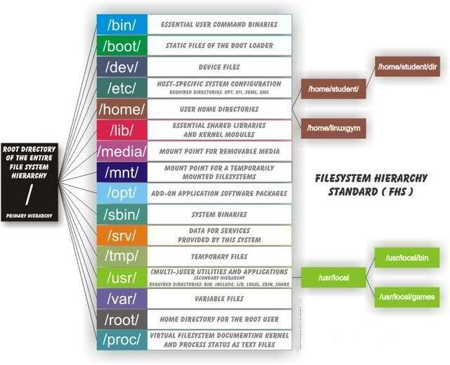
Filesystem Hierarchy Standard
Linux filesystem is a tree
Font::https://help.ubuntu.com/community/LinuxFilesystemTreeOverview

Slide 12
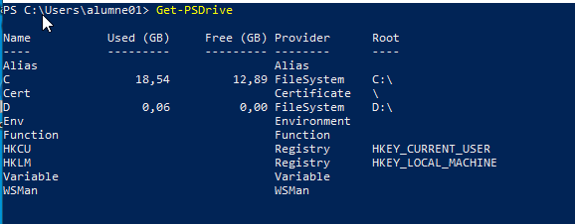
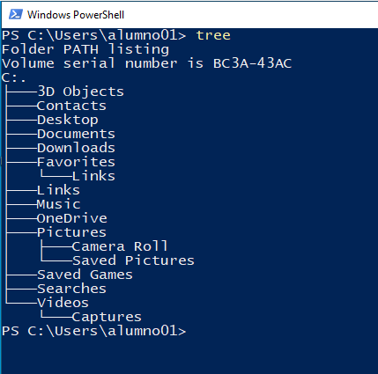
Windows 10 filesystem is a Volume or Volumes with trees
The most important files are in "C:\Windows\System32\"
All components are mapped as objects in a Register.
Registry
The registry or Windows Registry contains information, settings, options, and other values for programs and hardware installed on all versions of Microsoft Windows operating systems.
When a program is installed
A new subkey containing settings such as a program's location, its version, and how to start the program, are all added to the Windows Registry.

Slide 13
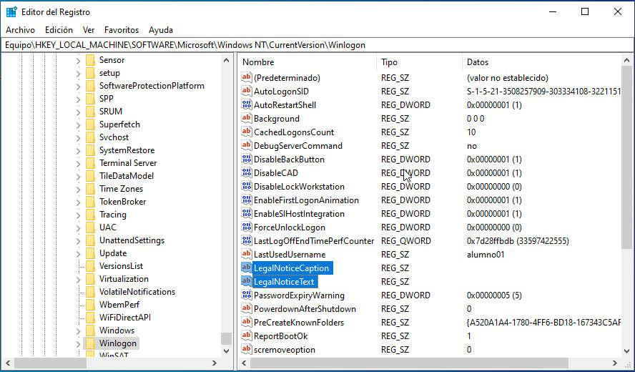
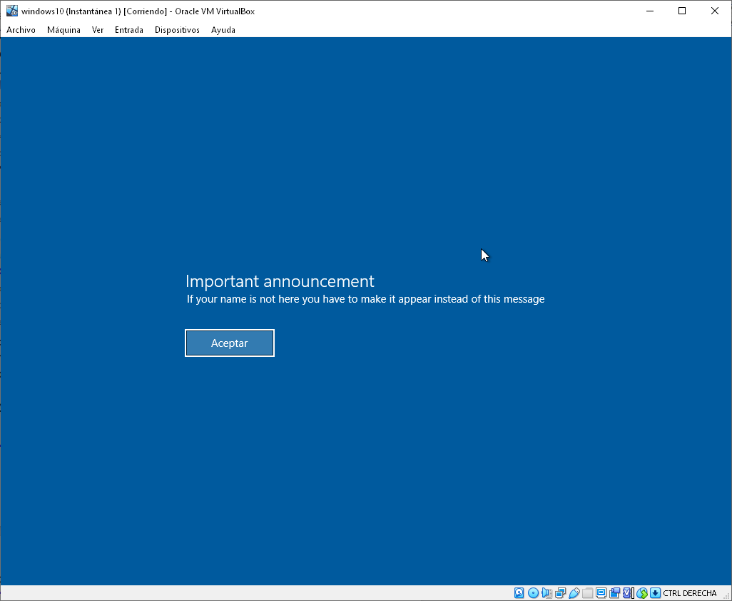
Key | Description
HKEY_CURRENT_USER | Information about the current user.
HKEY_USERS | Information about all users.
HKEY_LOCAL_MACHINE | Information about the computer.
HKEY_CLASSES_ROOT | Information about the extensions and their associations.
HKEY_CURRENT_CONFIG | Information about the current configuration being using.
Data types | Description
REG_BINARY | Binary data in hexadecimal format.
REG_DWORD | Double word data.
REG_EXPAND_SZ | Variable-length text string.
REG_MULTI_SZ | List or array separated by spaces.
REG_SZ | Fixed-length text string.
REG_FULL_RESOURCE_DESCRIPTOR | Nested tables.
Win+R and regedit
Branch
Key
Result
Value

Slide 14


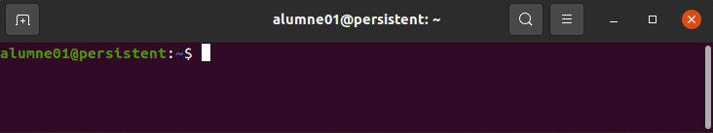
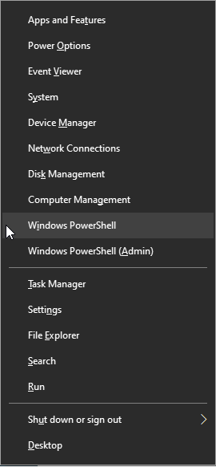
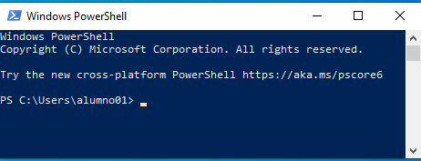
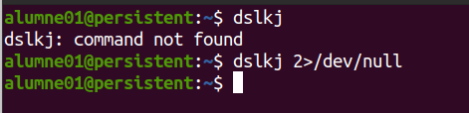
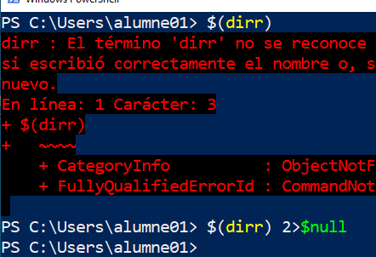
Starting the Shell
Ctrl+Alt+t
Prompt
Win+x and select Windows PowerShell
Stdout 1
Stderr 2
Stdin 0
https://www.explainshell.com/

Slide 15
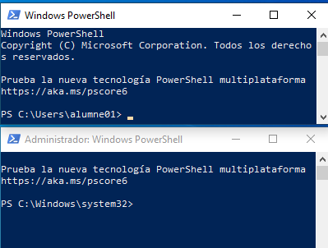
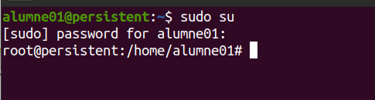
Commands features
Commands are commands, functions and alias.
command -[parameter] -- [argument]
Case sensitive.
Needs key word and selected commands as administrator. Last part of Prompt change $ to # for admin user.
Commands are cmdlets, functions and alias.
verb-noun -[parameter] -- [argument]
NO case sensitive.
Needs specific shell as administrator. Different path for admin.

Slide 16
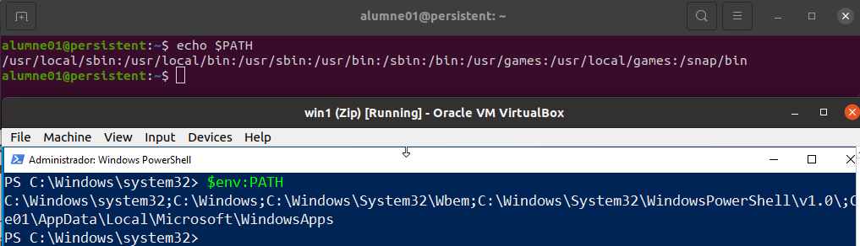
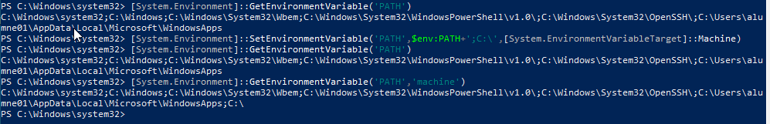
Path
Colon as a splitter
To get Path: echo $PATH
To set persistent
echo “export PATH=$PATH:/home” >> ~/.bashrc
Semicolon as a splitter
To get Path (machine, user, process):
[System.Environment]::GetEnvironmentVariable('PATH','machine')
To set persistent
[System.Environment]::SetEnvironmentVariable('Variable','Value',
[System.EnviorementVariableTarget]::Machine)
[<Name>.<.net type>]::<static method or property]

Slide 17
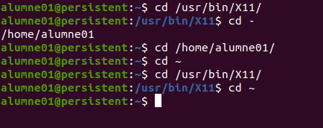
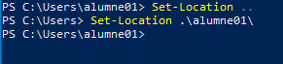
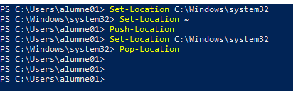
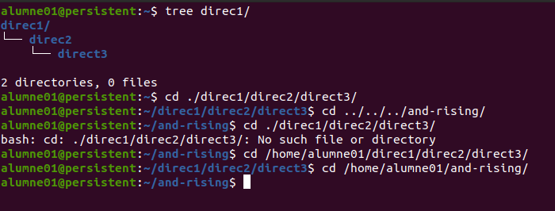
Relative vs Absolute
~ stands for Tilda(AtlGr+4) and means user directory absolute path.
. stands for current directory.
.. stands for parent directory.
pwd stands for print working directory.
cd stands for change directory.

Slide 18
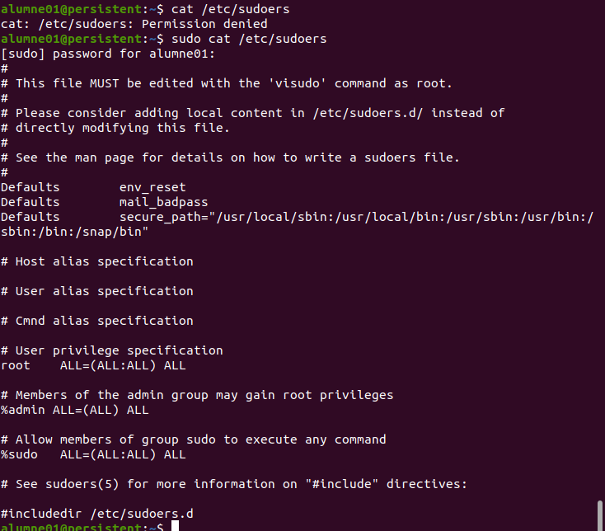
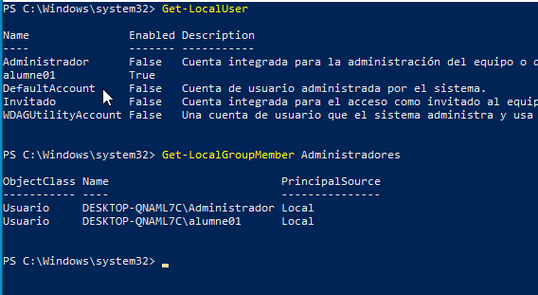
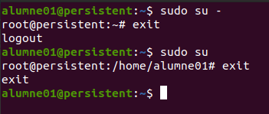
Users and Groups
/etc/login.defs
Administrator
User has complete control over a machine.
Standard User
Has access to machine but restricted to install or change certain settings.
Root user is a Superuser with UID=0
System users no login with (1 >=UID< 1000)+{65534 nobody}
Normal users 1000>=UID< 65533
sudo visudo /etc/sudoers
% stands for group. ALL, NOPASSWD PASSWD
! stands for exclude
user machine=(user_run_as) command
net user administrador /active:yes

Slide 19
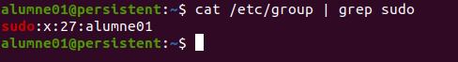
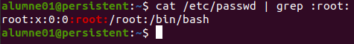
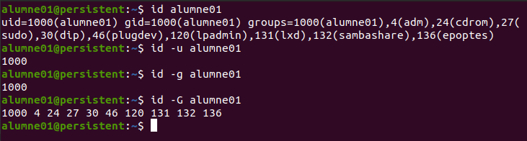
newgrp
Admin sets a password to access protect as a main group.
Login must be 8 characters max and begins without a number.
All user belongs to a primary group.
One user can be part to other groups.
A group can’t be part to another group.
Group:password:GID:user1,user2,...
Login:password:UID:GID:comment:homedir:shell
Group:password:admins_group:user1,user2,...
1
2
3
4
5
6
7
8
9
Login:alumne01
Encrypted password:$6$...
days from January 1, 1970 to last password changed:18586
days to can’t password change:0
days to must password change:99999
days to start notify before that password must change:7
days to account deactivation:
days from January 1, 1970 to account was deactivated:
reserved
man crypt
$1$ | MD5
$2a$ | Blowfish
$5 | SHA-256
$6 | SHA-512
Other | DES

Slide 20
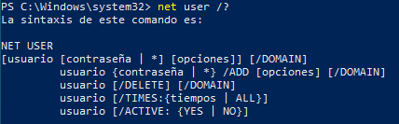
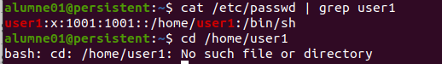
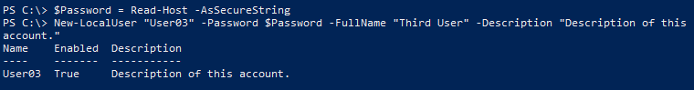
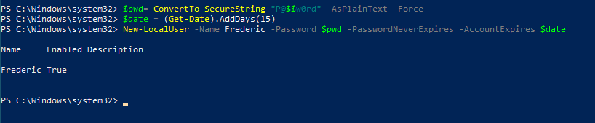
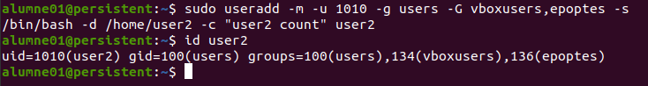
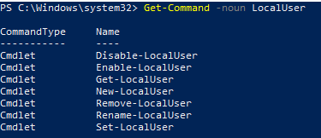
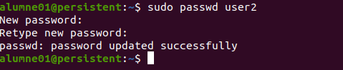
Add user
/etc/default/useradd
Command # useradd <options> login
Commands from CMD #PS C:\Windows\system32>
net user login <options>
net user Pepe /add
net user Pepe /*
net user Pepe /delete
net localgroup administradores Pepe /add or /delete
net user Victor /logonpasswordchg:yes
Cmdlet in PowerShell:
-m
-u
-g
-G
-d
-c
-k
-s
-p
Create home directory
Force user UID
Set primary user group
Set secondary groups i.e. group1, group2, ...
Personal directory path
Comments (user can modify with chfn)
User path directory tree
Shell
Encrypted password (better use command passwd)

Slide 21


groupmod
-n
-g
Rename group
<GID> Modify GID but not for files.
usermod
-L
-U
-e
-u
-l
-m
Lock account as passwd -l
Unlock account as passwd -u
<n> Password expires n days before 01/01/1970
<UID> Modify UID
<login> Modify login name
Move: Needs -d to specify new personal directory
groupadd
-f
-g
Success output if already exist
<GID> Set GID
gpasswd
-a
-d
-r
-M
-A
<user> <group> Add user to group
<user> <group> Delete user to group
remove password
<user1>,<user2> <group> Set the list of group members.
<admin1>,<admin2> <group> Set the list of administrative users.
groupdel
You must remove the user before you remove the group. You should manually check all file systems to ensure that no files remain owned by this group.

Slide 22




Set-LocalUser
-AccountExpires
-AccountNeverExpires
-Description
-Fullname
-Name
-Password
-PasswordNeverExpires
-SID
-UserMayChangePassword
<DateTime>
<String>
<String>
<String>
<SecureString>
<Boolean> $True or $False
<SecurityIdentifier>
<Boolean>
New-LocalGroup
-Description
-Name
<String>
<String>
Add-LocalGroupMember
-Group
-Memeber
-Name
-SID
<LocalGroup>
<LocalPrincipal[]>
<String>
<SecurityIdentifier>

Slide 23




Permissions
Command $ chmod <option o octal> file
Default for files 666(rw-rw-rw-)
Default for directories 777(rwxrwxrwx)
Unique Mask for the new files. Default 002(-------w-)
-r
-w
-x
Readable
Writable
Executable
System Access control List (SACLs)
Modify permission includes r,w,x.
Full control permission can change owner and its ACLs
List folder contents is an alias for Read&Execute on a directory.
Inherit exist.
Command icacls /?
Owner |  |  | Group |  |  | Other |  |  | Octal
r | w | x | r | w | x | r | w | x
400 | 200 | 100 | 40 | 20 | 10 | 4 | 2 | 1 | 777
400 | 200 | 100 | 40 |  | 10 | 4 |  | 1 | 755
400 | 200 |  | 40 |  |  | 4 |  |  | 644
chown -R <user> <file>
chgrp -R <group> <file>
chown -R <user>[:group] <file>

Slide 24



icacls <file> <option> /T /C /Q
/grant< |:r>
/deny
/remove<:g|:d>
/reset
<SID>:<permission>
<SID>:<permission>
<SID>
r stands for remplace permissions
g stands for grant
d stands for deny
/T stands for recursive files and directories
/C stands for not show error missatges and continue execution
/Q stands for not show correct operations report.
Special permissions

Slide 25




SUID-Bit (Set User ID Bit)
chmod u+s <command>
chmod 4755 <command>
GUID-Bit (Set Group ID Bit)
chmod g+s <command>
chmod 2755 <command>
s or S
Only owner or Admin can activate. SUID-Bit or SGID-Bit have sense with execution privilege previously activated(x) if not s is replaced to S.
Sticky bit (Protect files in directories)
chmod u+t <directory>
chmod 1777 <directory>
g+s in Directory
All files will be part of the same group that this directory.

Slide 26





Install app
APT (Advanced Package Tool)
Command $ sudo apt edit-sources
Command $ sudo apt update
Command $ sudo apt upgrade
Command $ sudo apt install aptitude
Command $ sudo apt remove xeyes
wget -q https://packages.microsoft.com/config/ubuntu/20.04/packages-microsoft-prod.deb
sudo dpkg -i packages-microsoft-prod.deb
sudo apt update
sudo apt -y install powershell
pwsh
Package Management
Install-PackageProvider
Find-Package
Install-Package
Get-Package
Security Level requeriment Get-ExecutionPolicy
Restricted
Allsigned
RemoteSigned
Unrestricted

Slide 27
To finish....
Thanks!

